Slide 1
Android + NDK + OpenCV

Slide 2

Android studio download
https://developer.android.com/studio?hl=ko

Slide 3
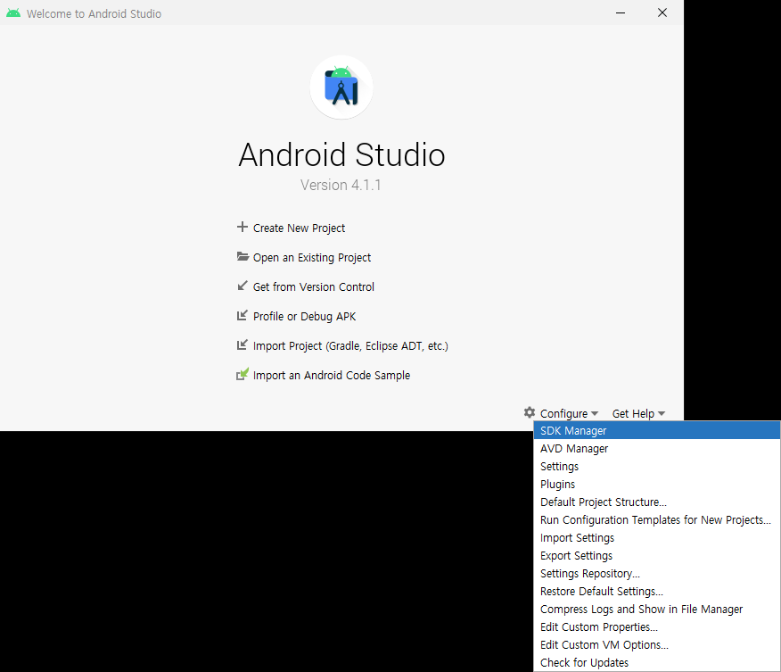
Development kit 설치

Slide 4
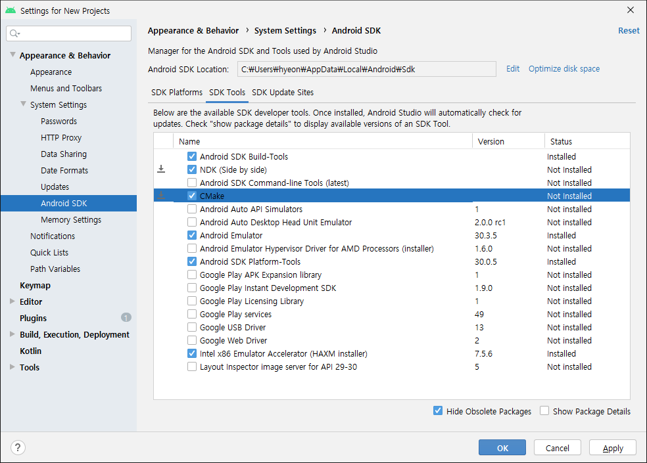
Development kit 설치
(1)
(2)

Slide 5
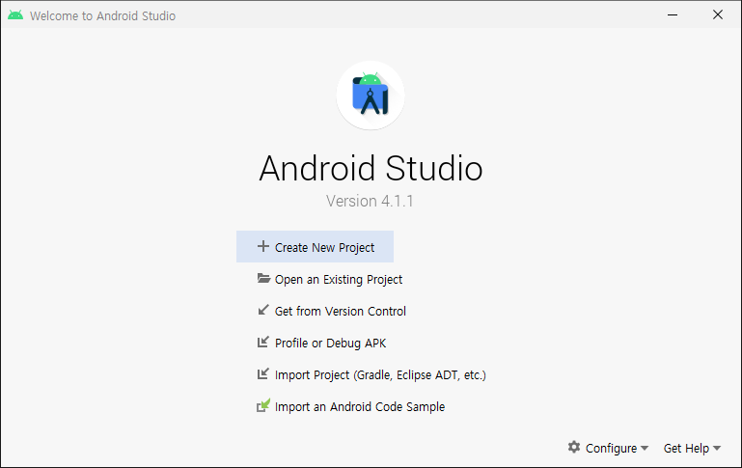
Project 생성

Slide 6
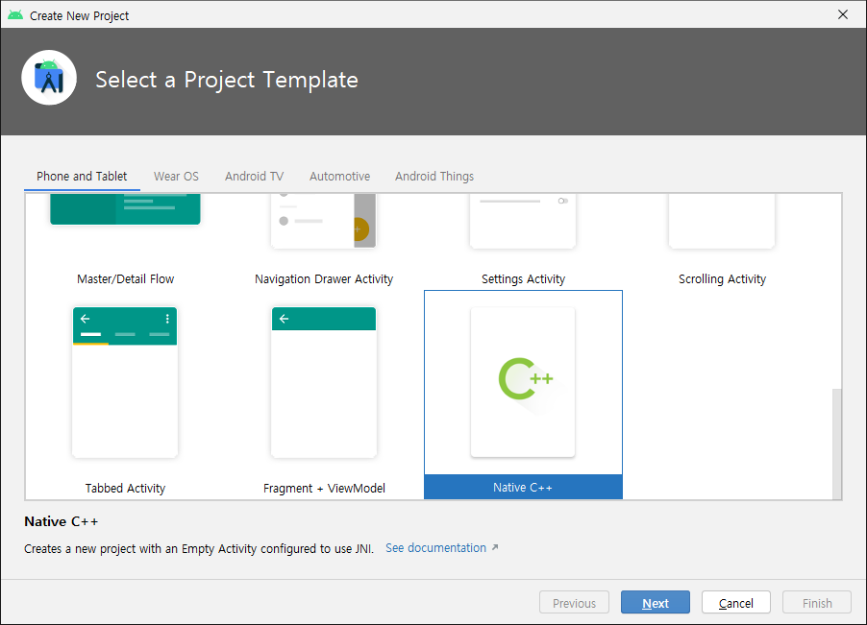
Project 생성

Slide 7
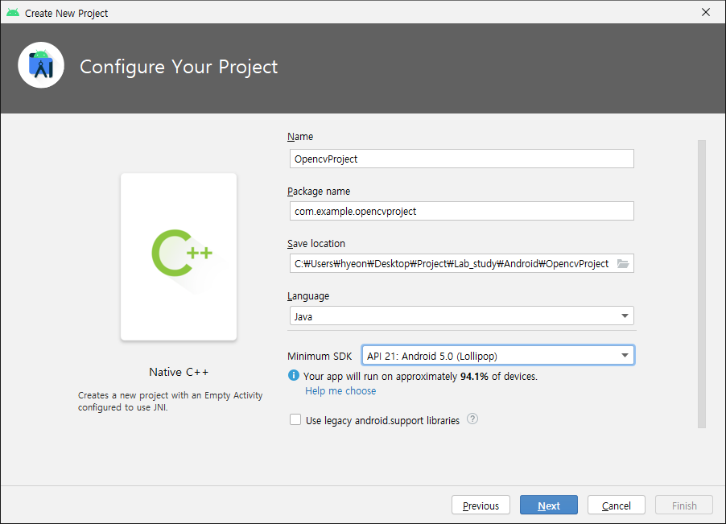
Project 생성

Slide 8
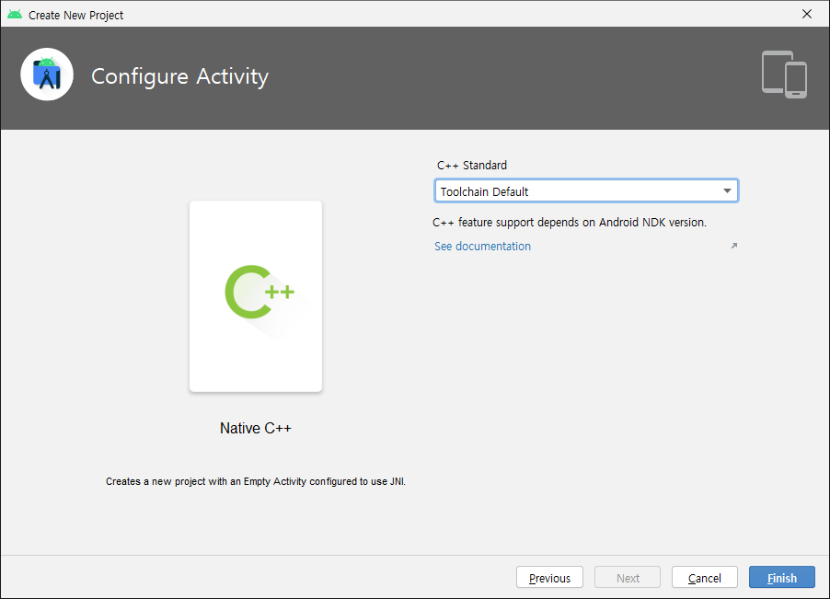
Project 생성

Slide 9

OpenCV download

Slide 10
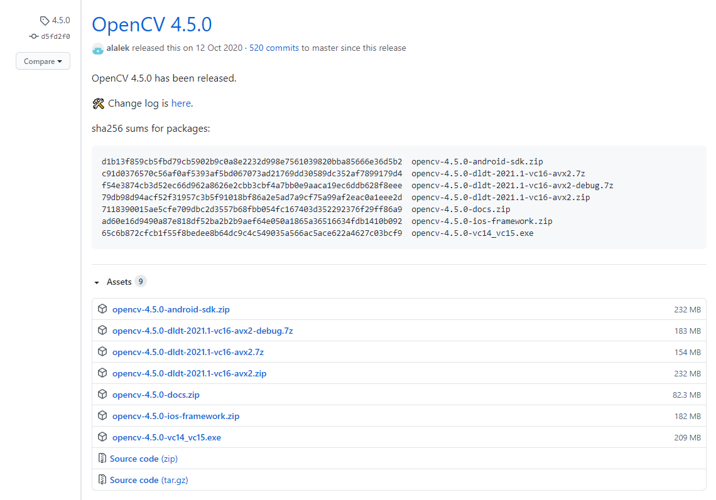
OpenCV download

Slide 11
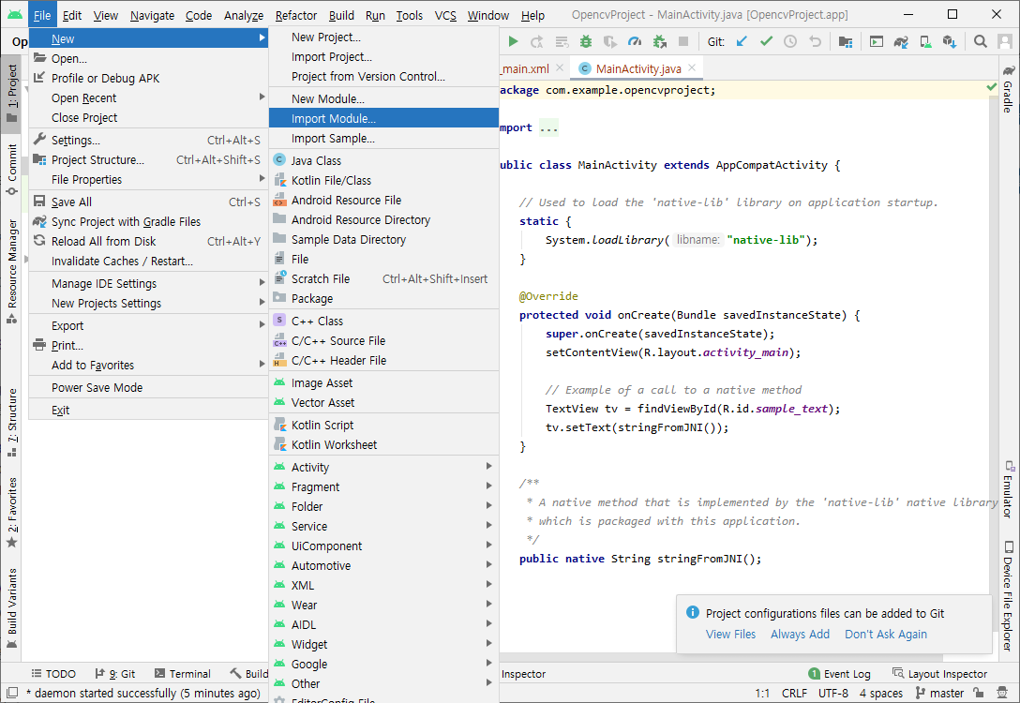
Import library (OpenCV)

Slide 12
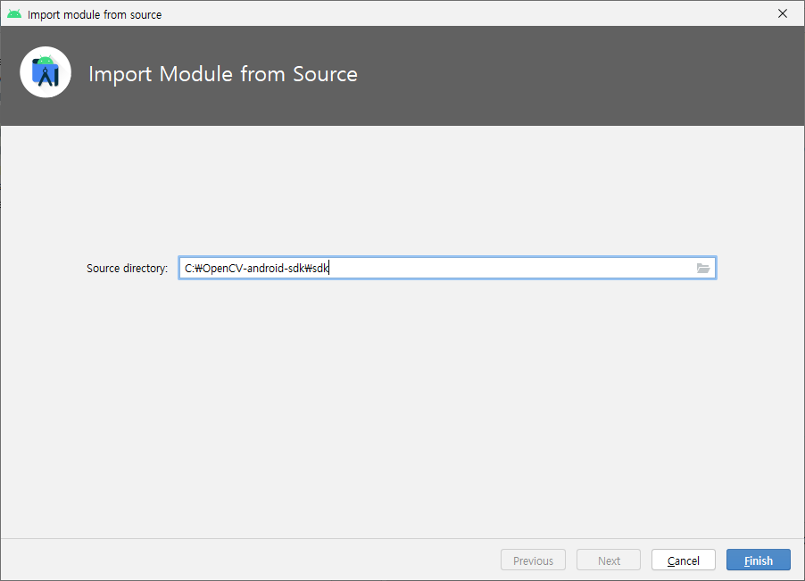
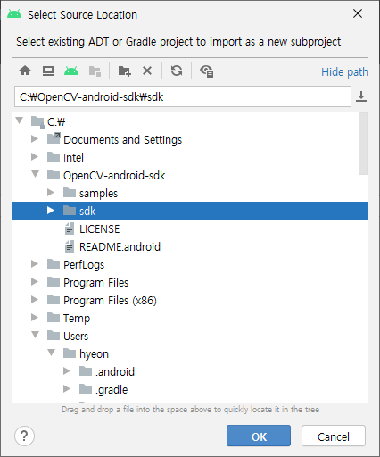
Import library (OpenCV)
(2)
(1)
(4)
(3)

Slide 13
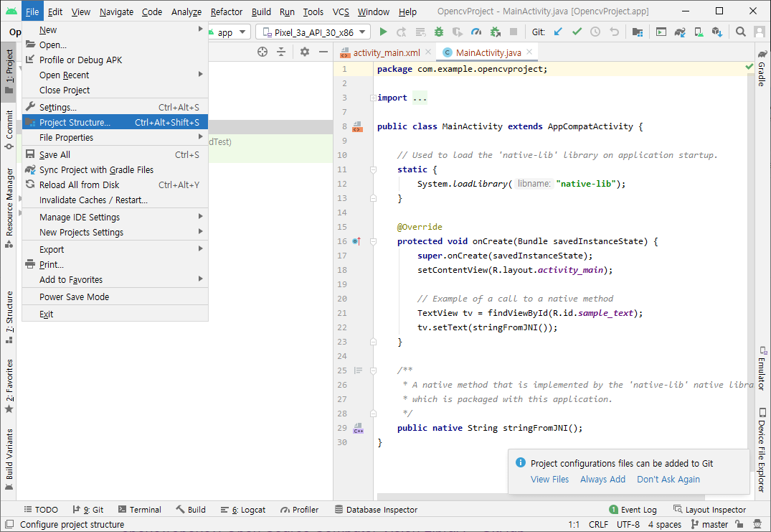
Import library (OpenCV)

Slide 14
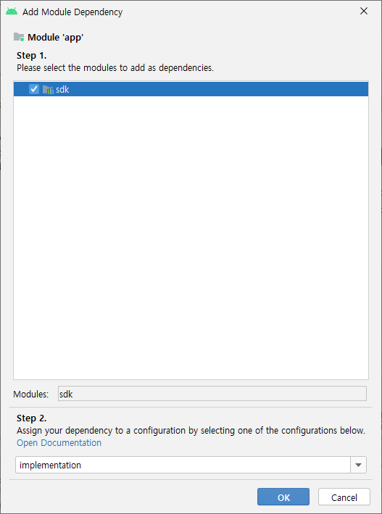
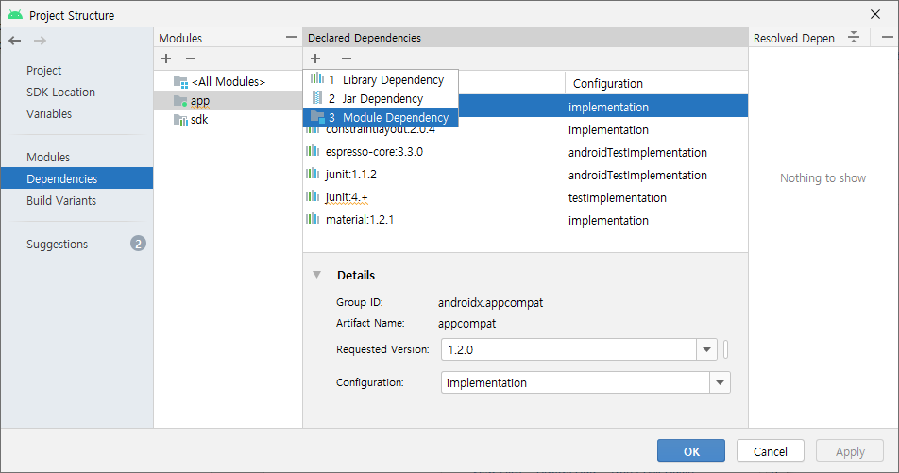
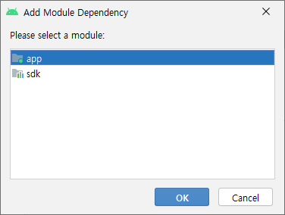
Import library (OpenCV)
(3)
(1)
(2)
(5)
(4)

Slide 15
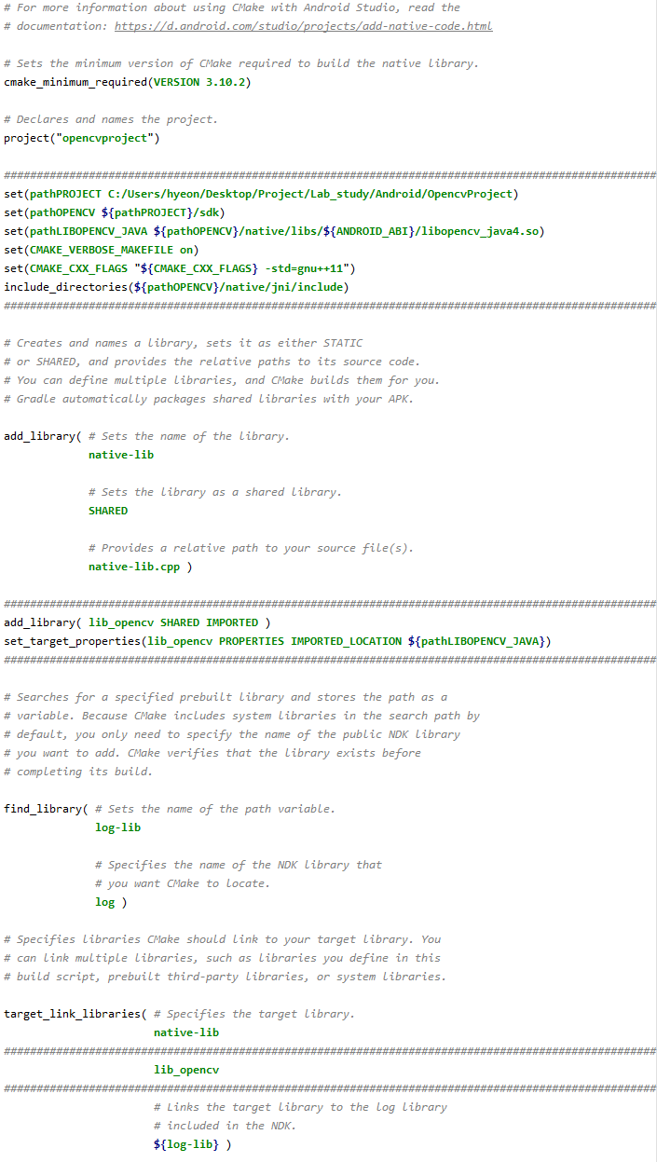
Import library (OpenCV)
Android : app > cpp > CMakeLists.txt
Project : [Project Name] > app > src > main > cpp > CMakeLists.txt
set(pathPROJECT C:/Users/hyeon/Desktop/Project/Lab_study/Android/OpencvProject)
set(pathOPENCV ${pathPROJECT}/sdk)
set(pathLIBOPENCV_JAVA ${pathOPENCV}/native/libs/${ANDROID_ABI}/libopencv_java4.so)
set(CMAKE_VERBOSE_MAKEFILE on)
set(CMAKE_CXX_FLAGS "${CMAKE_CXX_FLAGS} -std=gnu++11")
include_directories(${pathOPENCV}/native/jni/include)
add_library( lib_opencv SHARED IMPORTED )
set_target_properties(lib_opencv PROPERTIES IMPORTED_LOCATION ${pathLIBOPENCV_JAVA})

Slide 16
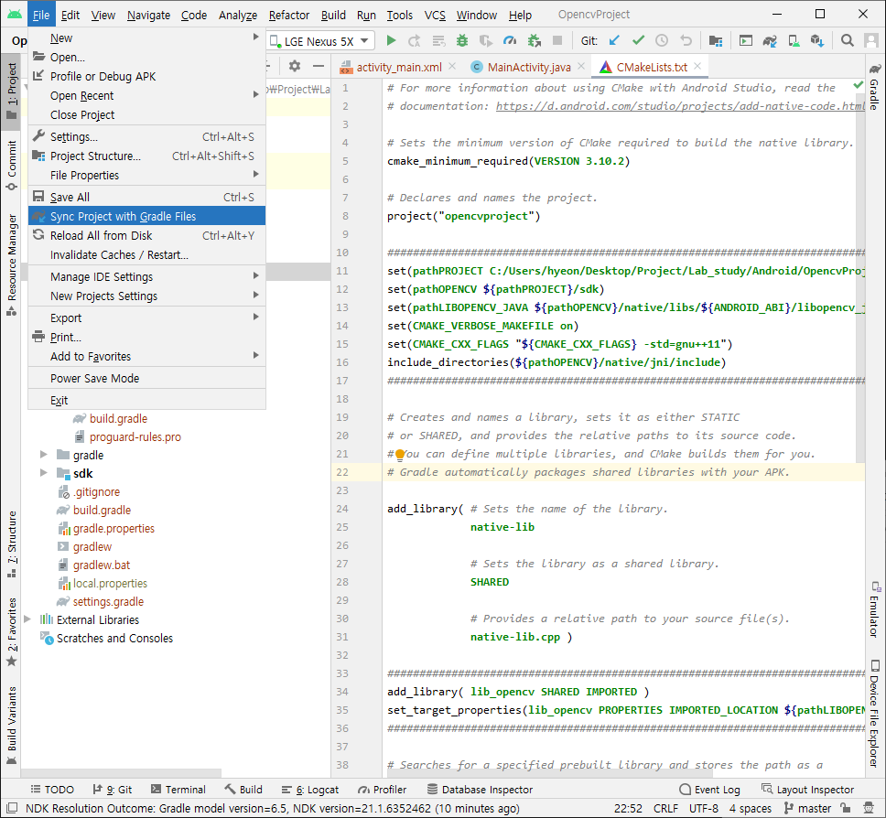
Import library (OpenCV)

Slide 17
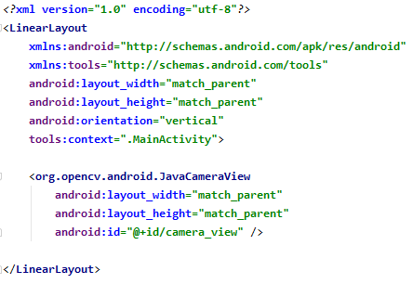
Example code
Layout
<?xml version="1.0" encoding="utf-8"?>
<LinearLayout
xmlns:android="http://schemas.android.com/apk/res/android"
xmlns:tools="http://schemas.android.com/tools"
android:layout_width="match_parent"
android:layout_height="match_parent"
android:orientation="vertical"
tools:context=".MainActivity">
<org.opencv.android.JavaCameraView
android:layout_width="match_parent"
android:layout_height="match_parent"
android:id="@+id/camera_view" />
</LinearLayout>

Slide 18
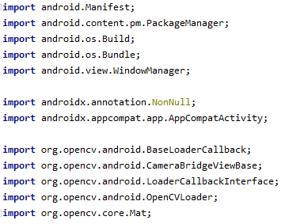
Example code
MainActivity
Import
import android.Manifest;
import android.content.pm.PackageManager;
import android.os.Build;
import android.os.Bundle;
import android.view.WindowManager;
import androidx.annotation.NonNull;
import androidx.appcompat.app.AppCompatActivity;
import org.opencv.android.BaseLoaderCallback;
import org.opencv.android.CameraBridgeViewBase;
import org.opencv.android.LoaderCallbackInterface;
import org.opencv.android.OpenCVLoader;
import org.opencv.core.Mat;

Slide 19
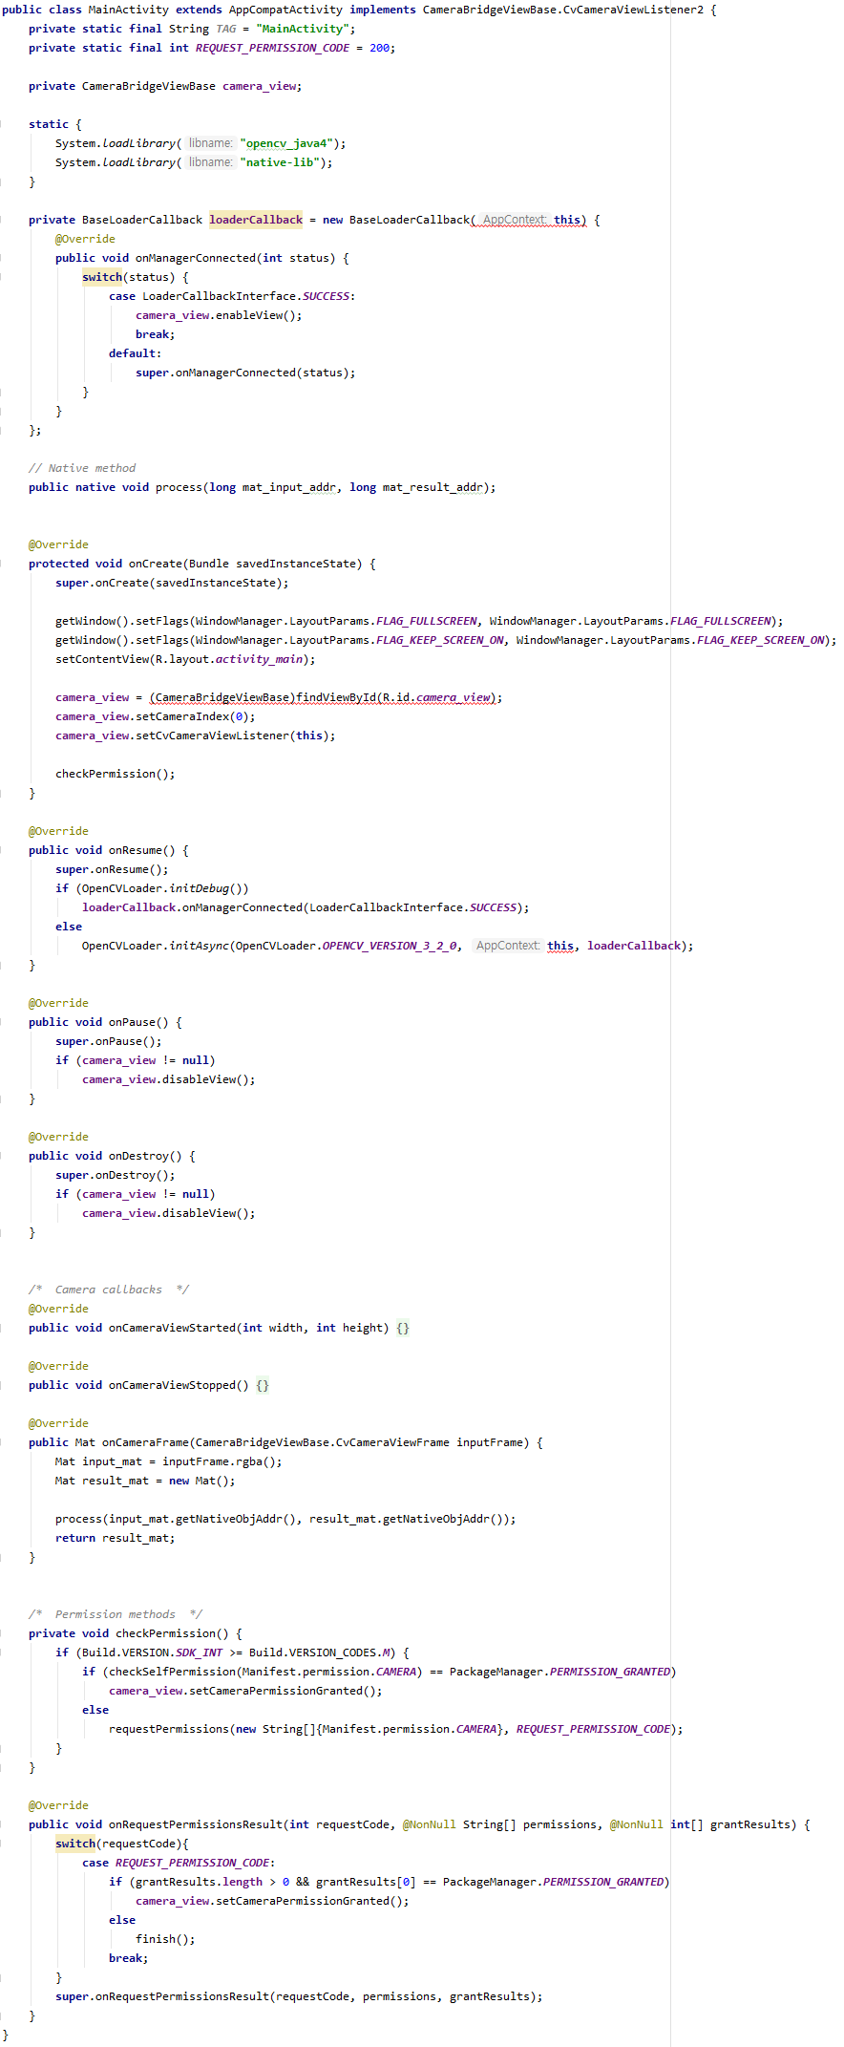
Example code
MainActivity
Code

Slide 20
Example code
MainActivity
Code
@Override
public void onPause() {
super.onPause();
if (camera_view != null)
camera_view.disableView();
}
@Override
public void onDestroy() {
super.onDestroy();
if (camera_view != null)
camera_view.disableView();
}
/* Camera callbacks */
@Override
public void onCameraViewStarted(int width, int height) {
}
@Override
public void onCameraViewStopped() {
}
@Override
public Mat onCameraFrame(CameraBridgeViewBase.CvCameraViewFrame inputFrame) {
Mat input_mat = inputFrame.rgba();
Mat result_mat = new Mat();
process(input_mat.getNativeObjAddr(), result_mat.getNativeObjAddr());
return result_mat;
}
/* Permission methods */
private void checkPermission() {
if (Build.VERSION.SDK_INT >= Build.VERSION_CODES.M) {
if (checkSelfPermission(Manifest.permission.CAMERA) == PackageManager.PERMISSION_GRANTED)
camera_view.setCameraPermissionGranted();
else
requestPermissions(new String[]{Manifest.permission.CAMERA}, REQUEST_PERMISSION_CODE);
}
}
@Override
public void onRequestPermissionsResult(int requestCode, @NonNull String[] permissions, @NonNull int[] grantResults) {
switch(requestCode){
case REQUEST_PERMISSION_CODE:
if (grantResults.length > 0 && grantResults[0] == PackageManager.PERMISSION_GRANTED)
camera_view.setCameraPermissionGranted();
else
finish();
break;
}
super.onRequestPermissionsResult(requestCode, permissions, grantResults);
}
}
public class MainActivity extends AppCompatActivity implements CameraBridgeViewBase.CvCameraViewListener2 {
private static final String TAG = "MainActivity";
private static final int REQUEST_PERMISSION_CODE = 200;
private CameraBridgeViewBase camera_view;
static {
System.loadLibrary("opencv_java4");
System.loadLibrary("native-lib");
}
private BaseLoaderCallback loaderCallback = new BaseLoaderCallback(this) {
@Override
public void onManagerConnected(int status) {
switch(status) {
case LoaderCallbackInterface.SUCCESS:
camera_view.enableView();
break;
default:
super.onManagerConnected(status);
}
}
};
// Native method
public native void process(long mat_input_addr, long mat_result_addr);
@Override
protected void onCreate(Bundle savedInstanceState) {
super.onCreate(savedInstanceState);
getWindow().setFlags(WindowManager.LayoutParams.FLAG_FULLSCREEN, WindowManager.LayoutParams.FLAG_FULLSCREEN);
getWindow().setFlags(WindowManager.LayoutParams.FLAG_KEEP_SCREEN_ON, WindowManager.LayoutParams.FLAG_KEEP_SCREEN_ON);
setContentView(R.layout.activity_main);
camera_view = (CameraBridgeViewBase)findViewById(R.id.camera_view);
camera_view.setCameraIndex(0);
camera_view.setCvCameraViewListener(this);
checkPermission();
}
@Override
public void onResume() {
super.onResume();
if (OpenCVLoader.initDebug())
loaderCallback.onManagerConnected(LoaderCallbackInterface.SUCCESS);
else
OpenCVLoader.initAsync(OpenCVLoader.OPENCV_VERSION_3_2_0, this, loaderCallback);
}

Slide 21
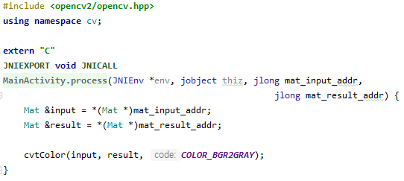
Example code
Native code

Slide 22
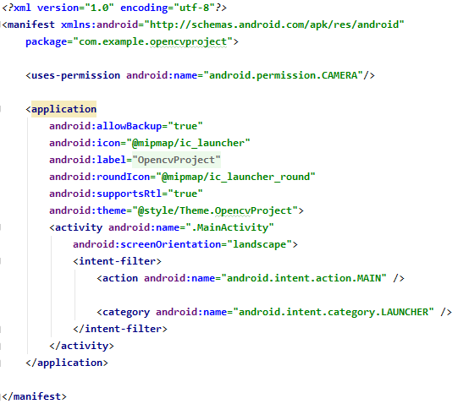
Example code
Manifest
카메라 권한
가로모드 고정

Slide 23
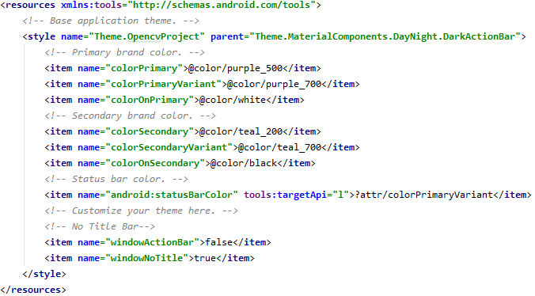
Example code
Themes
상단 바 제거

